Slide 1

FRAUDULENT FIRM CLASSIFICATION :
Leveraging Machine Learning to Identify Fraudulent Firms Using Current and Historic Risk Factors

Slide 2


1 | SHAIK MOHSIN HUSSAIN
2 | ASHRITH REDDY
3 | SANDEEP.P
TEAM
4 | J. VINAY

Slide 3
INTRODUCTION
" Audit " is defined as the process of examining the financial records of any business to corroborate that their financial statements are in compliance with the standard accounting laws and principles
Firms that resort to the unfair practices without the fear of legal repercussion have a grievous consequence on the economy and individuals in the society.
It is a very exacting task to detect firms in spotting frauds, detecting errors, and disclosing employees guilty of abetting illegal transactions.
Data analytics tools for an effective fraud management have become the need of the hour for an audit.

Slide 4
Objective
Goal of this project is to help the auditors by building a machine learning model by constructing a classification system capable of accurately identifying fraudulent firms by leveraging current and historic risk factors.

Slide 5
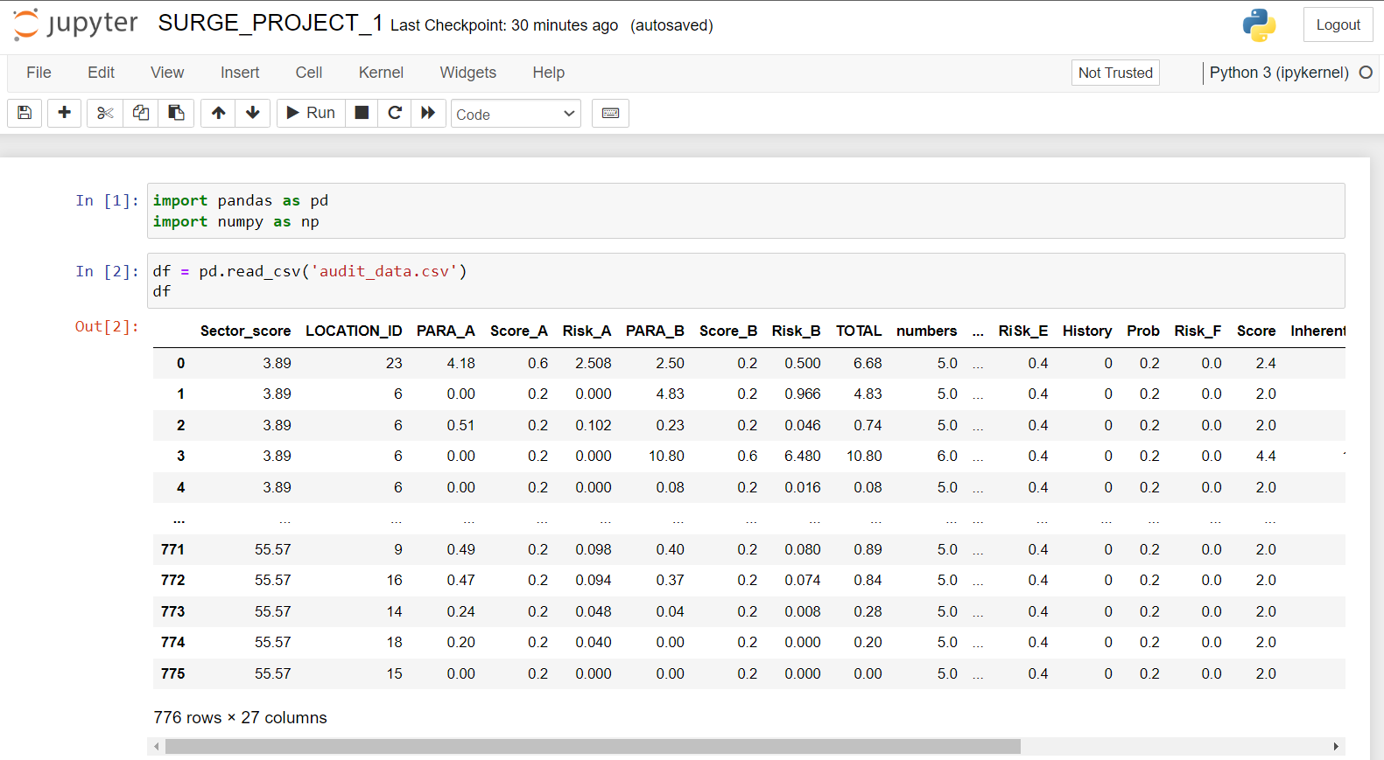
Data Description
The dataset was made available through a csv file – audit risk . The audit risk has 27 columns , thereby Considered ' Risk ' as the target column for classification tasks.

Slide 6
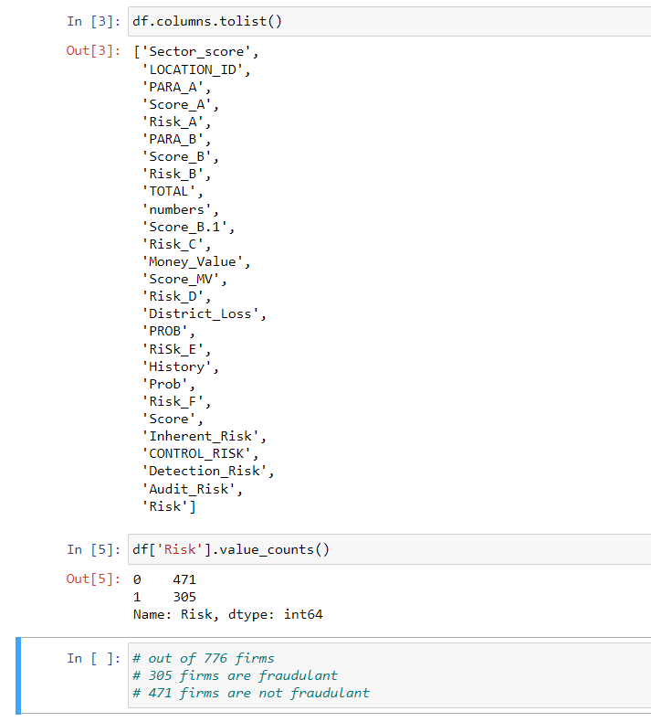
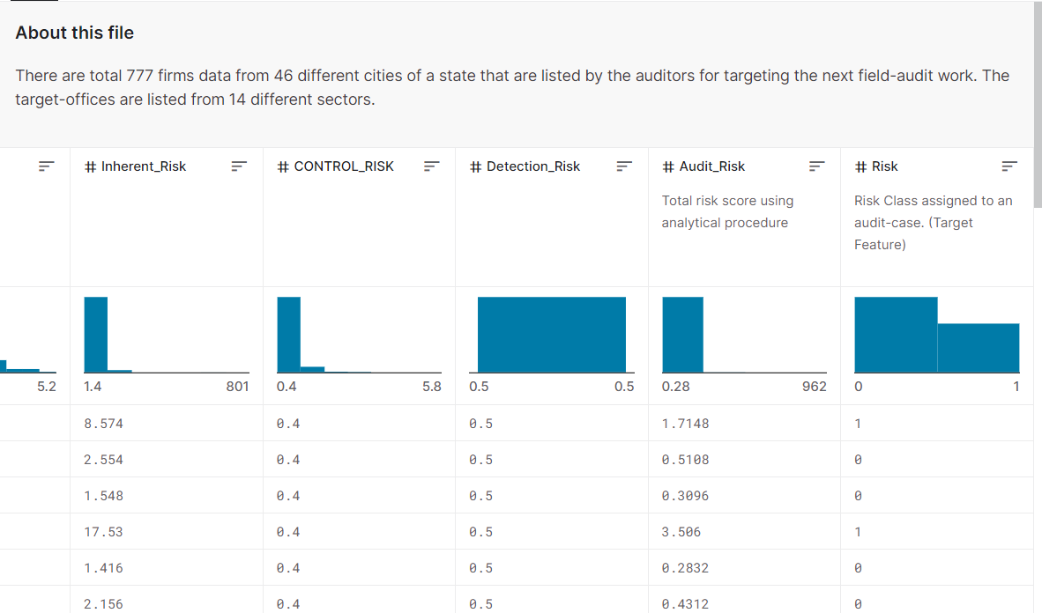
Data Description

Slide 7
APPROACHES
Random Forest | Linear Regression
Random Forest is an ensemble learning algorithm that combines multiple decision trees to make accurate predictions. By aggregating the predictions of individual trees, Random Forest improves accuracy and reduces the risk of overfitting. | Linear Regression establishes a linear relationship between input features and the target variable by fitting a straight line to the data. It aims to minimize the difference between predicted and actual values, estimating coefficients that represent the strength and direction of this relationship.

Slide 8
1 | Data Preprocessing
2 | Data Understanding
3 | Data Cleaning
ANALYSIS

Slide 9
EDA
It is an approach to analyzing datasets to summarize their main characteristics, often with visual methods.
EDA is used for seeing what the data can tell us before the modelling task.

Slide 10
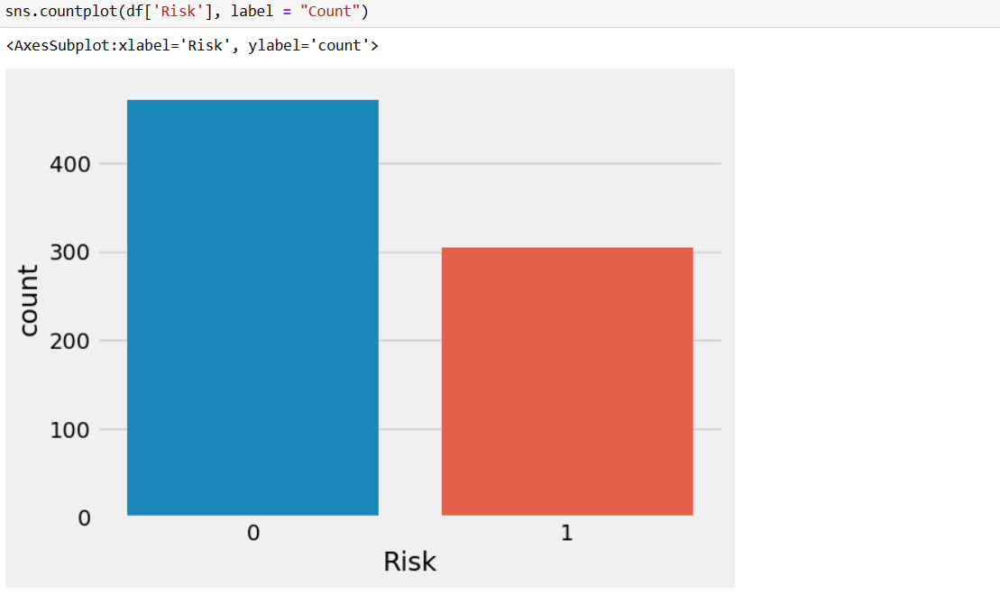
UNIVARIATE ANALYSIS

Slide 11
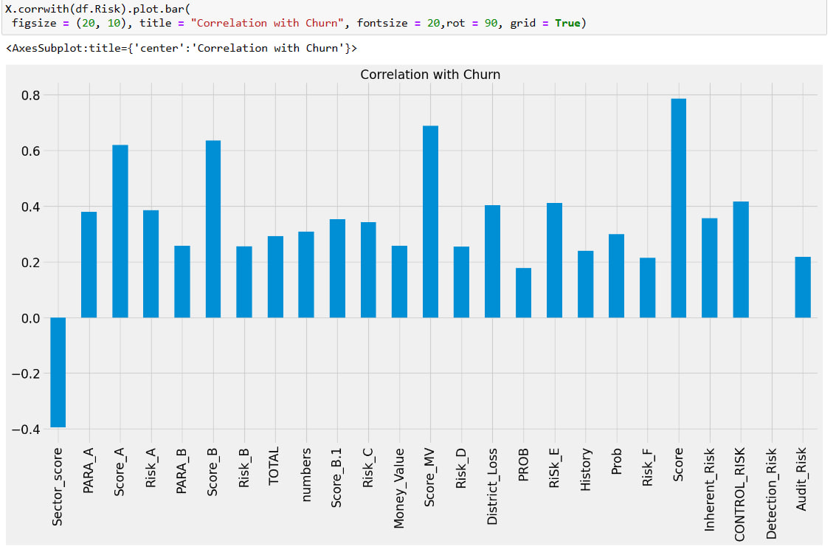
BIVARIATE ANALYSIS

Slide 12
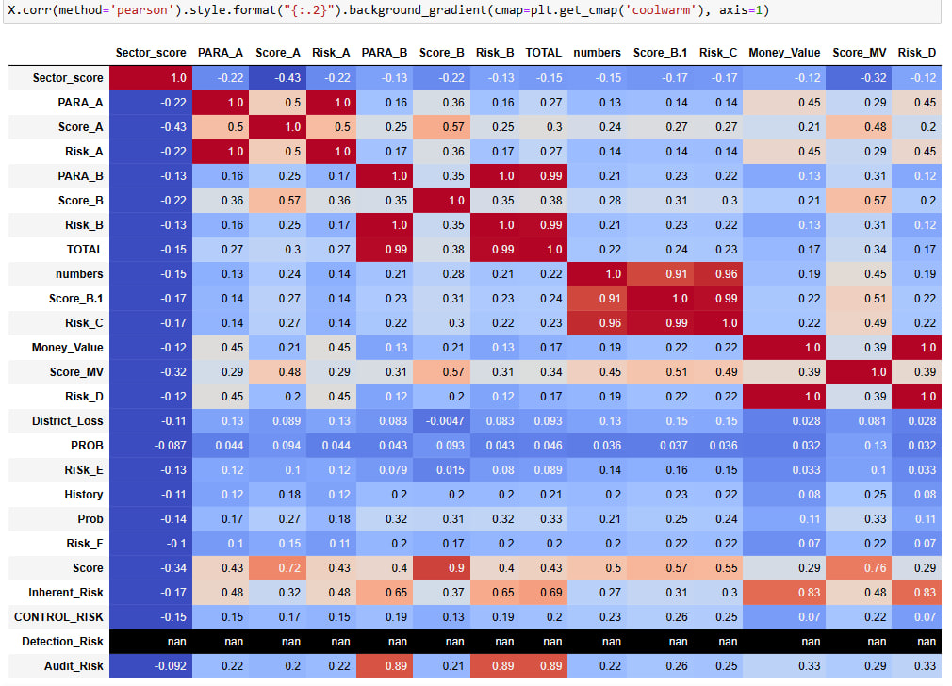
Observation: As we have seen there is no correlation of Detection Risk so it will be deleted before model building process as it is not contributing well enough for prediction process.

Slide 13
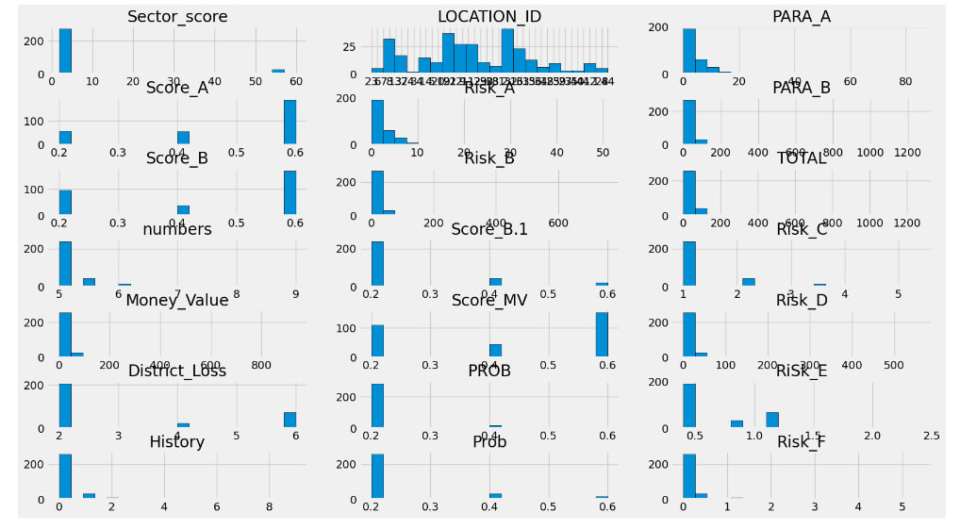
MULTIVARIATE ANALYSIS

Slide 14
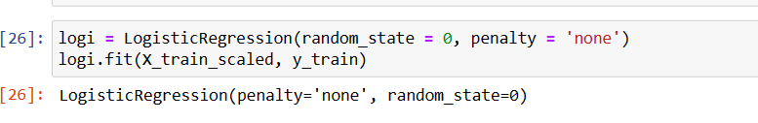
FEATURE SCALING
Feature scaling is a method used to normalize the range of independent variables or features of data. In data processing, it is also known as data normalization and is generally performed during the data preprocessing step.
APPLYING BASE MODEL: LOGISTIC REGRESSION

Slide 15
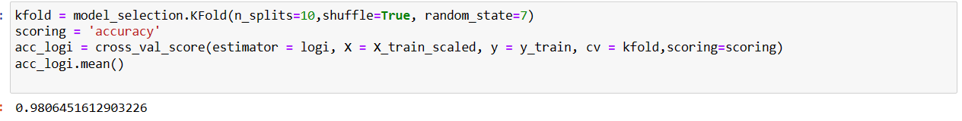
CROSS VALIDATION
Cross-validation is a technique for evaluating ML models by training several ML models on subsets of the available input data and evaluating them on the complementary subset of the data. Use cross-validation to detect overfitting, ie, failing to generalize a pattern

Slide 16
TRAIN TEST SPLIT
The train-test split procedure is used to estimate the performance Of machine learning algorithms when they are used to make predictions on data not used to train the model.
It is a fast and easy procedure to perform, the results of which allow you to compare the performance of machine learning algorithms for your predictive modeling problem. Although simple to use and interpret, there are times when the procedure should not be used, such as when you have a small dataset and situations where additional configuration is required, such as when it is used for classification and the dataset is not balanced.

Slide 17
LOGISTIC REGRESSION
Cross Validation
Model Evaluation
Result
The accuracy of Logistic Regression is 98%

Slide 18

RANDOM FOREST
Cross Validation
Model Evaluation
Result
The accuracy of Random Forest is 100%

Slide 19
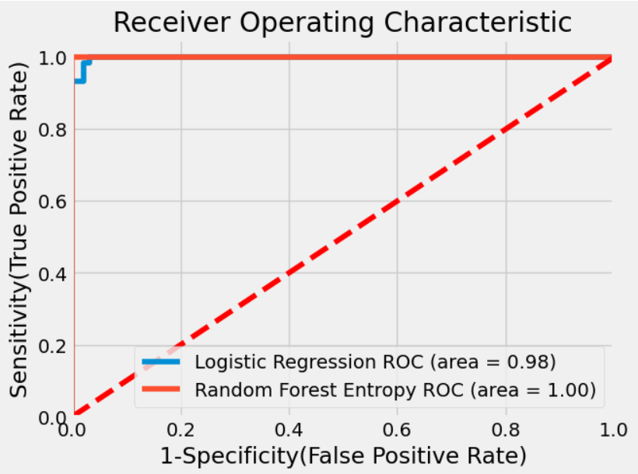
PLOTTING ROC AUC CURVE
AUC - ROC curve is a performance measurement for classification problems at various threshold settings.
Logistic Regression Sensitivity=(TP/TP+FN) = (60/60+1)=0.98 Specificity=(TN/TN+FP)=(93/93+2)=0.97 1-Specificity=0.03 •
Random Forest Classifier Sensitivity=(TP/TP+FN) = (61/61+0)= 1 Specificity=(TN/TN+FP)=(95/95)=1 1-Specificity=0

Slide 20
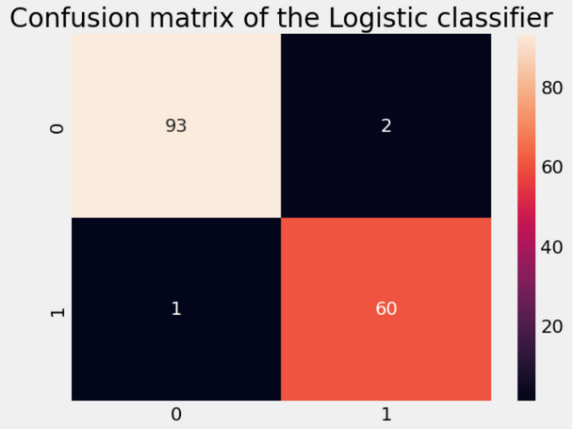
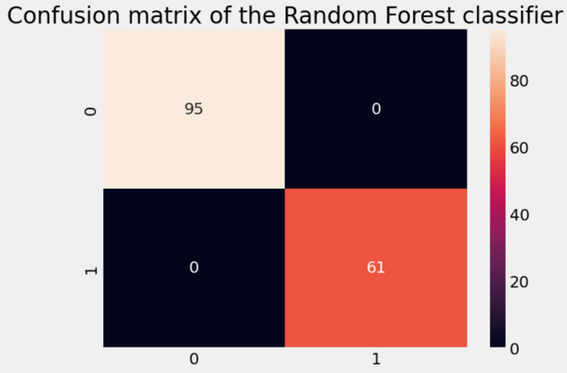
CONFUSION MATRIX
A confusion matrix is a table that is often used to describe the performance of a classification model (or "classifier") on a set of test data for which the true values are known The confusion matrix itself is relatively simple to understand, but the related terminology can be confusing
Result: -
There are 93 firms with true negative and 60 true positive •
There is 1 false negative and 2 false positive
Result: -
There are 95 firms with true negative and 61 true positive •
There is 0 false negative and 0 false positive

Slide 21
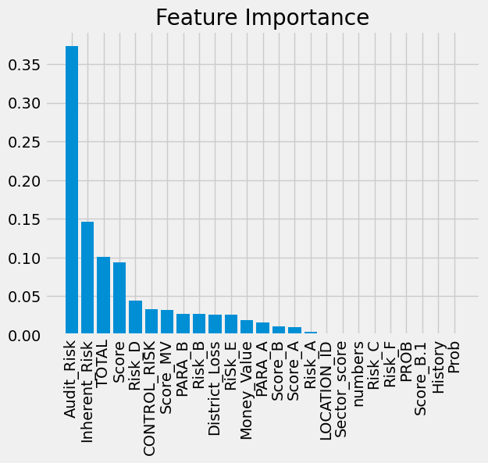
FEATURE IMP PLOT

Slide 22
CONCLUSION
This PowerPoint presentation showcases to explore the feasibility of utilizing machine learning methods for predicting fraudulent firms during the audit planning process.
A complete Audit Field Work Decision Support framework is proposed to help an auditor to decide the amount of field work required for a particular firm and to skip visiting low risk firms.
Fraudulent firm prediction is an important step at the preliminary stage of an audit planning as high-risk firms are targeted for the maximum audit investigation during field engagement.

Slide 23
CONCLUSION
Different types of risks are explored and then calculated mathematically for the audit dataset using the audit risk formula.
Two state-of-the-art classifiers like LR RF are implemented.
The application of machine learning in fraudulent firm detection presents significant opportunities for auditors to enhance their capabilities in identifying fraudulent activities. By leveraging advanced algorithms, comprehensive data analysis, and domain expertise, auditors can improve their fraud detection rates, reduce risks, and protect the interests of stakeholders.

Slide 24
THANK YOU

